Slide 1
General view of nervous coordination
Ram Balak Mahto
Guest faculty
Zoology department
v.s.j college Rajnagar Madhubani
Class 12th
7908055676

Slide 2
Irritability
The ability to respond to environmental stimuli is a fundamental property of life.
Single celled organisms respond in a simple way – e.g. avoiding a noxious substance.
The evolution of multicellularity required more complex
mechanisms for communication between cells.
Neural mechanisms – rapid, brief
Hormonal mechanisms – slower, long term

Slide 3
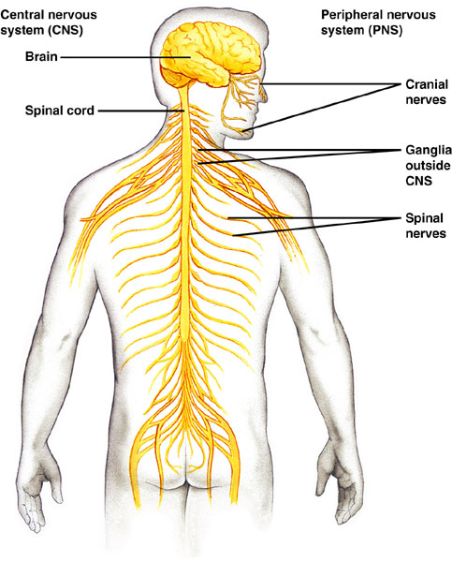
CNS & PNS
Central Nervous System (CNS) – includes the brain and spinal cord.
Peripheral Nervous System (PNS) – includes motor and sensory neurons.

Slide 4
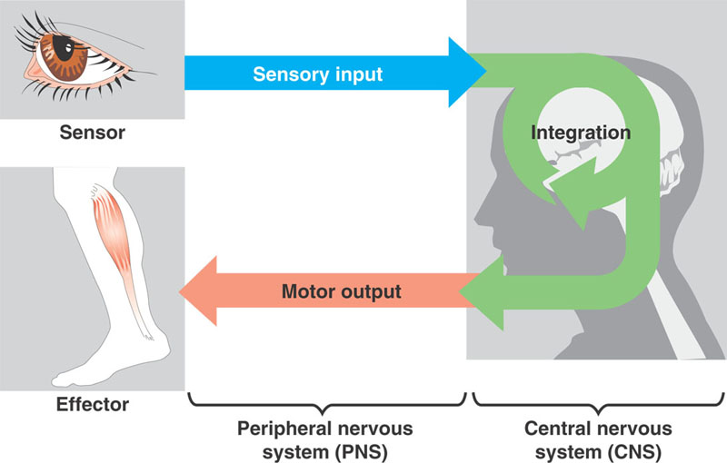
Neurons
A neuron (nerve cell) is the functional unit of the nervous system.
Sensory (afferent) neurons carry impulses from sensory receptors to the CNS.
Motor (efferent) neurons carry impulses away from the CNS to effectors (muscles and glands).
Interneurons connect neurons together.

Slide 5
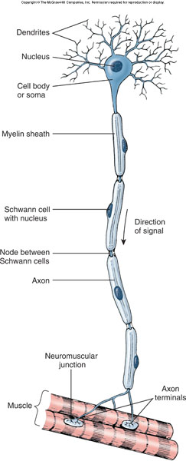
Neurons
Two types of cytoplasmic processes extend from the cell body.
Dendrites bring signals in to the cell body.
Often highly branched.
Axons carry signals away from the cell body.

Slide 6
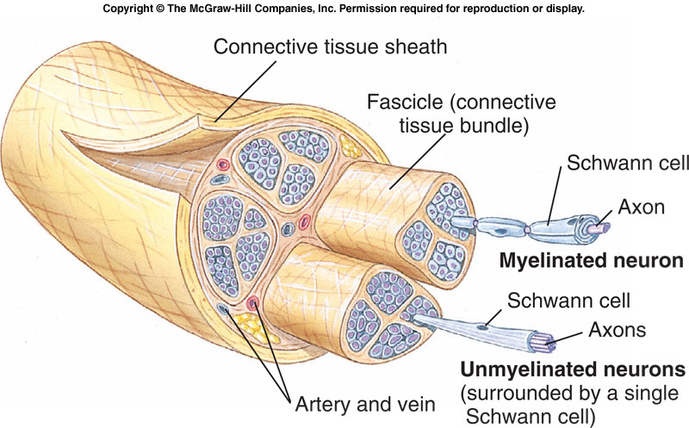
Nerves
Nerve processes (usually axons) are often bundled together, surrounded by connective tissue, forming a nerve.
Cell bodies are located in the CNS or in ganglia (bundles of cell bodies outside the CNS).

Slide 7
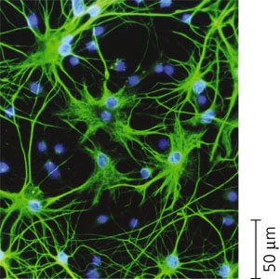
Glial Cells
Non-neural cells that work with neurons are called glial cells.
Astrocytes – star-shaped cells that serve as nutrient and ion reservoirs for neurons.

Slide 8
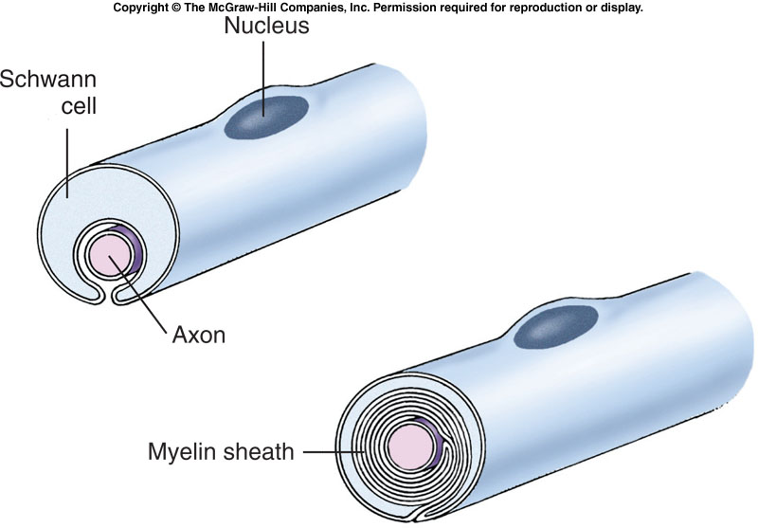
Glial Cells
The axon is covered with an insulating layer of lipid-containing myelin, which speeds up signal propagation.
Concentric rings of myelin are formed by Schwann cells in the PNS and oligodendrocytes in the CNS.

Slide 9
Action Potential
A nerve signal or action potential is an electrochemical message of neurons.
An all-or-none phenomenon – either the fiber is conducting an action potential or it is not.
The signal is varied by changing the frequency of signal conduction.

Slide 10
The Nerve Impulse
Across its plasma membrane, every cell has a voltage called a membrane potential.
The inside of a cell is negative relative to the outside.

Slide 11
The Nerve Impulse
Neuron at rest – active transport channels in the neuron’s plasma membrane pump:
Sodium ions (Na⁺) out of the cell.
Potassium ions (K⁺) into the cell.
More sodium is moved out; less potassium is moved in.
Result is a negative charge inside the cell.
Cell membrane is now polarized.

Slide 12
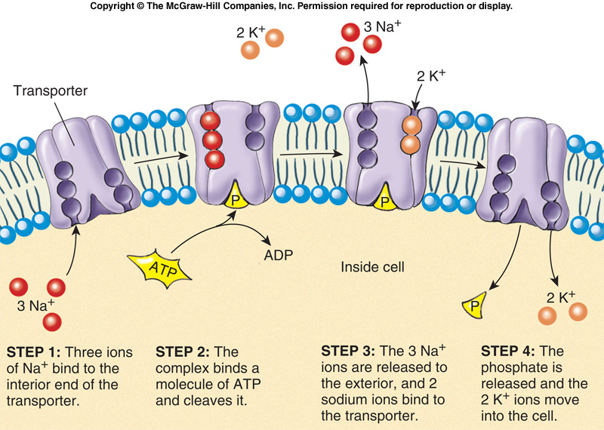
Sodium-Potassium Exchange Pump
Na⁺ flows into the cell during an action potential, it must be pumped out using sodium pumps so that the action potential will continue.
potassium

Slide 13
Thank you

